Slide 1
Unix v. Windows
Based on lecture notes from the following:
Phil Pfeiffer, Ron Zucker, & Jack Ramsey – ETSU
Hussam Abu-Libdeh – Cornell University
Eric Eaton – University of Pennsylvania

Slide 2
Unix vs. Windows
Underneath the Windows GUI, which hides Windows' internals, Unix and Windows have much in common
Windows was originally developed atop a Unix clone, CP/M
Both conform, to varying degrees, to an overarching standard for OS functionality, POSIX
The Windows file system has much the same structure as the Unix system
The Windows command line processor affords a subset of the functionality provided by the Unix command line processor
Presentation here focuses on comparing Unix with Windows, so as to teach something about both

Slide 3
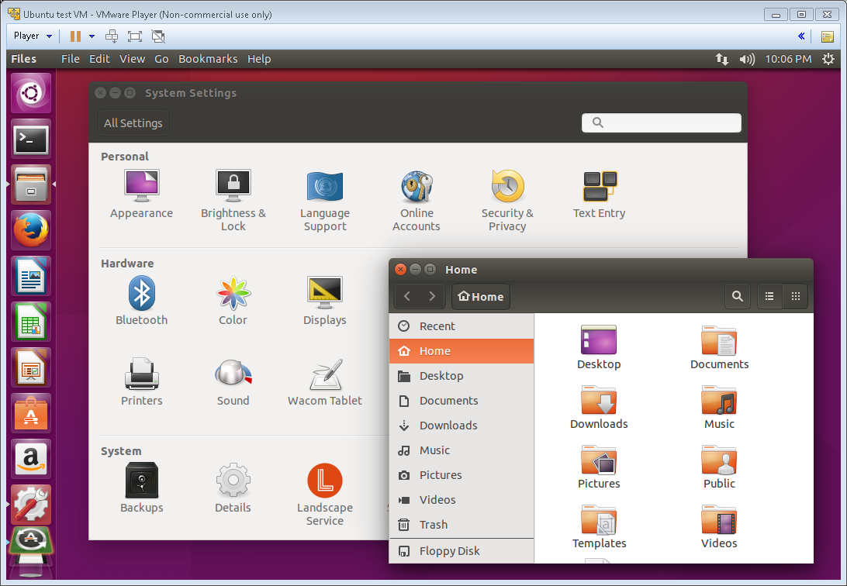
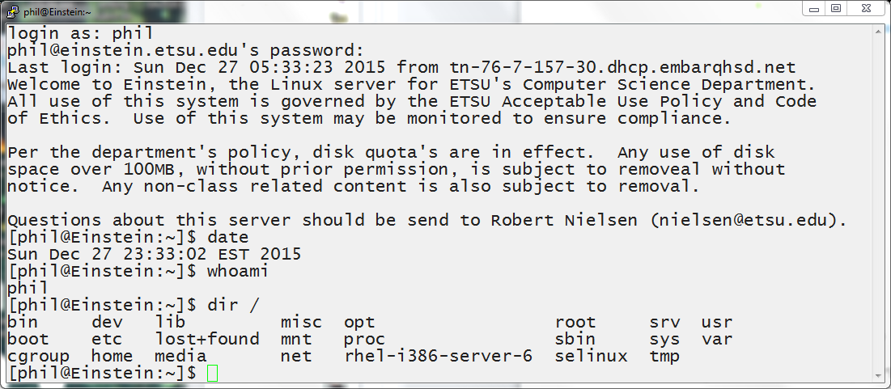
Command Interpreters: How Unix is Like Windows
Most Unix systems support a graphical user interface (GUI)
All Unix systems support an MS/DOS-like (cmd-like) character-based command line interface (CLI)

Slide 4
Command Line Interface (CLI) Commands: How Unix is Like Windows
Much of the Unix CLI should seem familiar to cmd users
cmd (i.e., MS/DOS) based on CP/M, a late 1970's OS
CP/M, in turn, was developed as a stripped-down Unix
Common Unix/Windows functionality includes commands for
directory management: e.g., create/delete/rename directory
file management: e.g., create/delete/rename file
text file processing
system administration

Slide 5
Command Line Interface (CLI) Commands: How Unix is Like Windows
Common functionality also includes similar mechanisms for executing commands: e.g.,
running individual commands
running two or more commands concurrently (&)
pausing or halting a command's execution from the terminal (^Z, ^C)
rerouting a program's input from the keyboard to a file (<)
rerouting a program's output from the console to a file (>)
chaining one command's output to a second's input (|)
automating command execution, via scripts

Slide 6
Command Line Interface (CLI) Commands: How Unix is Like Windows
The Windows cmd prompt and most Unix CLIs, including bash, support a home directory: a file system directory where users can keep their files
on login, the CLI's set a user's current directory to that user's home directory
these systems track the current user's home directory using an environment variable named
HOME in UNIX
HOMEPATH in Windows

Slide 7

CLI Commands: How Unix, Windows Differ
Unix is geared towards CLIs
Graphical User Interfaces (GUIs) weren't supported when Unix created (1972)
'70s era memories were too small for pixelated displays
GUIs retrofitted during 80's, '90s
X, KDE, GNOME, Unity …
CLI remains essential for most "interesting" work

Slide 8
CLI Commands: How Unix, Windows Differ
Command name styles
To compensate for s-l-o-w 1970's era dialup connections, Unix commands were often severely abbreviated: e.g., cp, mv
Windows command names are typically clearer: e.g., copy, rename

Slide 9
CLI Commands: How Unix, Windows Differ
Policies for interpreting case
Windows command names are case insensitive: e.g., mkdir = MkDiR = MKDIR
For Unix, case matters: e.g., mkdir ≠ MkDiR ≠ MKDIR

Slide 10
CLI Commands: How Unix, Windows Differ
Command name choices
Windows and Unix use different names for some comparable commands: e.g., dir, rename, xcopy (Windows) vs. ls, mv, cp -r (Unix)
Windows and Unix use the same name for some very different commands: e.g., find (file search in Windows vs. file system search in Unix)
Command semantics
In some cases, related Windows and Unix commands operate in significantly different ways: e.g., echo, cd

Slide 11
CLI Commands: How Unix, Windows Differ
Support for a synonym for the home directory
Most Unix CLIs, including bash, treat an initial ~ in file names as a synonym for the current user's home directory
e.g., cd ~ will change user bob's current working directory (pwd) to /home/bob/, regardless of bob's current directory
Windows cmd doesn't support such a synonym

Slide 12
CLI Commands: How Unix, Windows Differ
Syntax for specifying command options
Windows options
follow a command's arguments
are signalled by / e.g., DIR foo /A:H
Unix options
precede a command's arguments,
are usually signaled by - or -- e.g., ls –a foo, ls –-all foo

Slide 13
CLI Commands: How Unix, Windows Differ
Support for scripting
Unix
most command interpreters, including bash, act as expressive and feature-rich languages in their own right

Slide 14
CLI Commands: How Unix, Windows Differ
Support for scripting
Windows
Windows PowerShell, which is typically used as a pure scripting language rather than an interpreter
cmd
a badly crippled version of Unix's /bin/sh
ported to MS/DOS's predecessor in the 1970's
☞ as of Summer 2016, Microsoft has ported bash to Windows 10

Slide 15
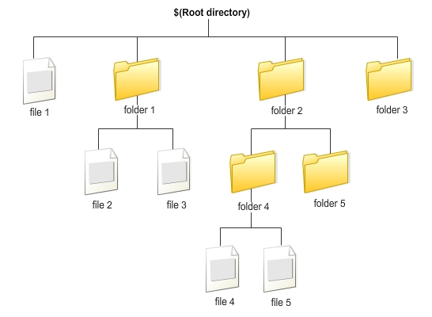
Command Line Interface (CLI) Commands: How Unix is Like Windows
Both support the use of files to store content
File: an ordered stream of content that can be accessed by name

Slide 16
Command Line Interface (CLI) Commands: How Unix is Like Windows
Both group files into roughly hierarchical (i.e., tree-ish) file systems
top level, root directory contains all system files, directories
each file and directory, by default, is in exactly one parent directory
directories can nest; files don't

Slide 17
Command Line Interface (CLI) Commands: How Unix is Like Windows
Both provide two types of path expressions for naming files and directories
Absolute path expressions
are grounded at well-known positions in the hierarchy, like root or home directory
Examples
Windows: C:\Users\ramseyjw\file.txt
Unix: /usr/ramseyjw/file.txt

Slide 18
Command Line Interface (CLI) Commands: How Unix is Like Windows
Both provide two types of path expressions for naming files and directories
Relative path expressions
grounded at a user-settable working (i.e., current) directory
Examples
Windows: ramseyjw\file.txt
Unix: ramseyjw/file.txt

Slide 19
Command Line Interface (CLI) Commands: How Unix is Like Windows
Both support two types of cross-connections from directories to other files and directories
cross-references by name
called links in Windows
called soft links or symbolic links in Unix
cross-references by logical device address
called junctions in Windows
called hard links in Unix

Slide 20

Command Line Interface (CLI) Commands: How Unix is Like Windows
This cross-referencing is why the Unix and Windows file systems aren't true hierarchies.
This ability to "include" a directory or file in two or more directories is also why I'll use the term directory in preference to folder.

Slide 21
File Management: How Unix is Like Windows
Both associate each file system item with an owner
Both associate each file system item with a set of permissions
managed by a file system item's owner
convey rights to access an item, based on whether a user is an item's
owner
a member of a specific group of users
"everyone else"

Slide 22
File Management: How Unix is Unlike Windows
Device naming
Windows, by default, pairs storage devices with logical drives
Windows presents devices as A:\, C:\, D:\, … Z:\
Properly, a set of hierarchies
Unix pairs storage devices with directories
Unix's view of a file system has one nameless root, /
Note: Since NT, Windows supports the pairing of devices with directories. This pairing, however, is typically done by admins rather than casual users.

Slide 23
File Management: How Unix is Unlike Windows
File naming
Windows
disallows names with <>:/|\"?* , most nonprinting characters
treats \ as its path separator
treats names as case-insensitive: i.e., foo = FOO

Slide 24
File Management: How Unix is Unlike Windows
File naming
Unix
only disallows names with nul
Note: most versions of Unix also disallow / in file names
treats / as its path separator
treats names as case-sensitive: i.e., foo ≠ FOO ≠ Foo

Slide 25
File Management: How Unix is Unlike Windows
File formats
While Unix and Windows share a host of common file types,
including text files, object files, library files, executable files, and archives, the two systems' native binary file formats are incompatible
Text files can be transferred between Unix and Windows.
Transfers, however, require an extra conversion step to account for differences in the two systems' formats

Slide 26
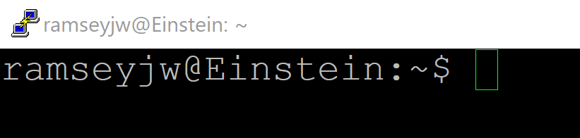
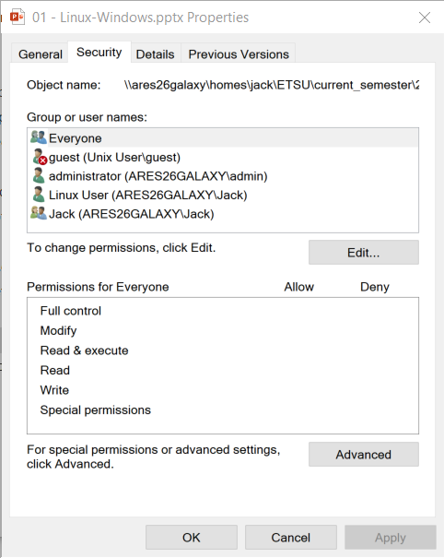
File Management: How Unix is Unlike Windows
The basic Unix permissions mechanism is crude by today's standards
it's a simplified version of Multics permissions
Rationale: Multics permissions were too elaborate for the limited memory and power of '70's-era systems
Contemporary Windows systems support a more precise access-control-list mechanism

Slide 27
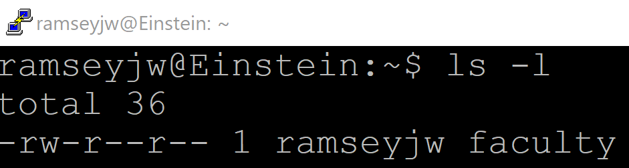
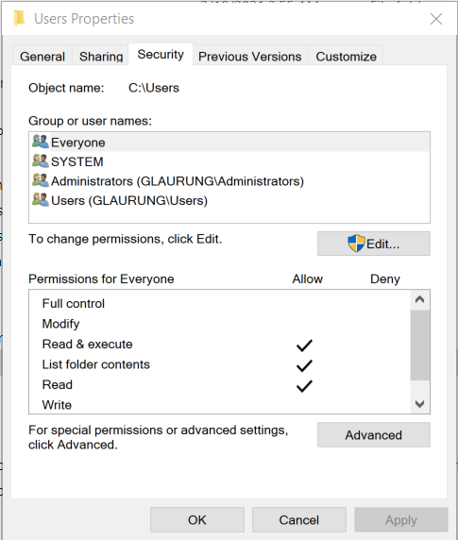
File Management: How Unix is Unlike Windows
Classic Unix supports three sets of permissions per file system item
for an object owner
for others in the owner's group
classic Unix puts each user in one group
this, regardless of the number of "actual" different organizational groups a user might be working with
for everyone else

Slide 28
File Management: How Unix is Unlike Windows
Windows supports many categories of permissions for each item
Windows allows users to be in multiple groups
A user who doesn't own an item gets the greatest degree of access to that item that this user's groups afford, except when a "Deny" permission is set

Slide 29
File Management: How Unix is Unlike Windows
Basic Unix limits permission types to
read (r)
write (w)
execute (x)
Windows also supports full control, list contents, delete, and user-configurable special combinations of permissions

Slide 30
File Management: How Unix is Unlike Windows
Windows has a special "Deny" "permission"
When set for a group to which a user belongs, that user is denied that kind of access to an item, regardless of how many "Allow" permissions apply to other groups
Classic Unix has nothing like "Deny"

Slide 31
File Management: How Unix is Unlike Windows
Newer Unixes provide optional support for access control lists (ACLs)
use of ACLs indicated in listings with final period after permissions
Allow users to be in multiple groups
Allow owners to specify rwx-style permissions for each group
Support a "deny"-like capability
ACLs are managed using utilities discussed in 4417 (system administration)

Slide 32

User Management: How Unix is Like Windows
Both typically configured as multi-user systems
Both enable access using accounts – identities that
allow a system to audit system use, using logs
limit what each user can do, to protect the system and other users

Slide 33
User Management: How Unix is Like Windows
Both associate each account with
a password – a string for authenticating a user on login
files and directories that the account owns – i.e., manages access to
one or more groups – which facilitate file sharing
configuration files – which personalize the look and feel of a user's sessions
a command interpreter – i.e., a utility that processes CLI commands

Slide 34
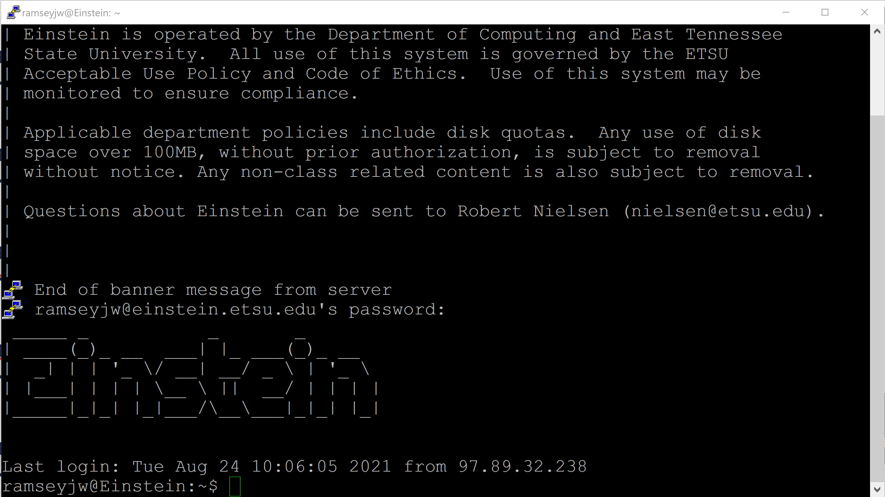
User Management: How Unix is Like Windows
Unix uses sessions as a middle ground between
no authentication at all and
authenticating users before every command

Slide 35
User Management: How Unix is Like Windows
How sessions work
sessions start with a log in, wherein users
request use of an account
demonstrate their right to use it with a password or other means
users remain authenticated (logged in) until the session ends
sessions end with a log out – either user-initiated (exit) or automatic, after session is idle for certain time

Slide 36
User Management: How Unix is Unlike Windows
Unix only supports one-level authentication
authentication ID specified as just an account
different machines require different logins

Slide 37
User Management: How Unix is Unlike Windows
Windows also supports two-level authentication
authentication ID specified as domain\account: e.g., etsu\ramseyjw
domain often defaulted for convenience
login to a domain gives user the right to access resources in the domain, like local computers, printers, and servers
these, however, may require secondary logins
domains – also called organizational units (OUs) – can be configured for automated cross-domain authentication

Slide 38
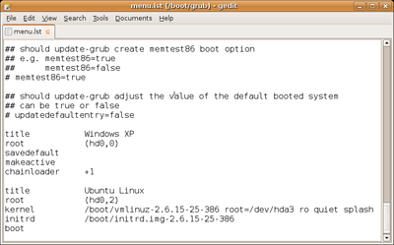
Configuration Management: How Unix is Like Windows
Both support use of well-known datasets to configure operation
These datasets are typically read on program startup
They typically serve to configure system programs, system-wide user defaults, and per-user defaults, like
Current system's time zone
GUI and command-line preferences
Both use text-based formats: e.g., .INI; JSON; (name, value) pairs

Slide 39
Configuration Management: How Unix, Windows Differ
Unix stores system-wide configuration files in a directory called /etc
All configuration data editable using text editors
Windows now stores most configuration data in the registry
A single, massive, central, system-wide binary file
Requires a special program, regedit.exe, to view and edit
Other classic locations for config data include C:\Windows, C:\Users

